Slide 1
Digital Portfolio
STUDENT NAME: S. HARSHAVARTHINI
REGISTER NO: 36324U18014
NMID : 67120051ABC16C08DED4F1D9AC8CD1F0
DEPARTMENT: COMPUTER SCIENCE
COLLEGE: SREE ABIRAAMI ARTS & SCIENCE COLLEGE FOR WOMEN / THIRUVALLUVAR UNIVERSITY

Slide 2
PROJECT TITLE
Design and Development of a Student Digital Portfolio Using Front-End Technologies "Showcasing Student Skills through a Front-End Based Digital Portfolio.
My Journey Online: A Student Digital Portfolio with HTML, CSS, and JavaScript.

Slide 3


AGENDA
Problem Statement
Project Overview
End Users
Tools and Technologies
Portfolio design and Layout
Features and Functionality
Results and Screenshots
Conclusion
GitHub Link
3/21/2024 Annual Review

Slide 4

PROBLEM STATEMENT
Students often lack a structured platform to digitally showcase their academic achievements, projects, and skills. Traditional resumes fail to highlight creativity, design, and interactivity, which employers value. Without a digital portfolio, students face difficulties in presenting their work to recruiters or higher education institutions.

Slide 5

PROJECT OVERVIEW
It allows students to showcase their academic achievements, skills, and projects in an interactive way. The portfolio is developed using HTML, CSS, and JavaScript to ensure responsiveness and user-friendliness. The design emphasizes clean UI/UX for better presentation and easy navigation. It helps students in personal branding and provides a professional platform for career opportunities.

Slide 6

WHO ARE THE END USERS?
Students – to create and showcase their personal achievements, projects, and skills. Teachers/Mentors – to evaluate and guide students’ growth through their portfolio. Recruiters/Employers – to view students’ skills and select suitable candidates. Academic Institutions – to assess student performance and digital presentation skills.

Slide 7

TOOLS AND TECHNIQUES
Front-End Tools: HTML, CSS, JavaScript, React (for creating interactive and responsive interfaces).Design Tools: Figma, Canvas (for UI/UX mockups and creative visuals).Collaboration Tools: GitHub, Trello, Google Workspace (for version control and teamwork).Techniques: Responsive Web Design, Wire framing, Prototyping, and User Testing to improve usability and performance.

Slide 8
POTFOLIO DESIGN AND LAYOUT
Simple & Clean Layout – easy navigation and minimal clutter. Responsive Design – works smoothly on mobile, tablet, and desktop. Consistent Theme – uniform fonts, colors, and styles. Visual Balance – proper use of white space and alignment. Highlighting Strengths – projects and skills showcased clearly.
8

Slide 9
FEATURES AND FUNCTIONALITY
Interactive Navigation – smooth and easy movement across sections. Search & Filter Options – quick access to projects or skills. Responsive Design – adapts to all screen sizes. Fast Loading Speed – optimized for performance. Project Showcase – detailed previews with descriptions. Contact/Feedback Form – simple way for users to connect.

Slide 10
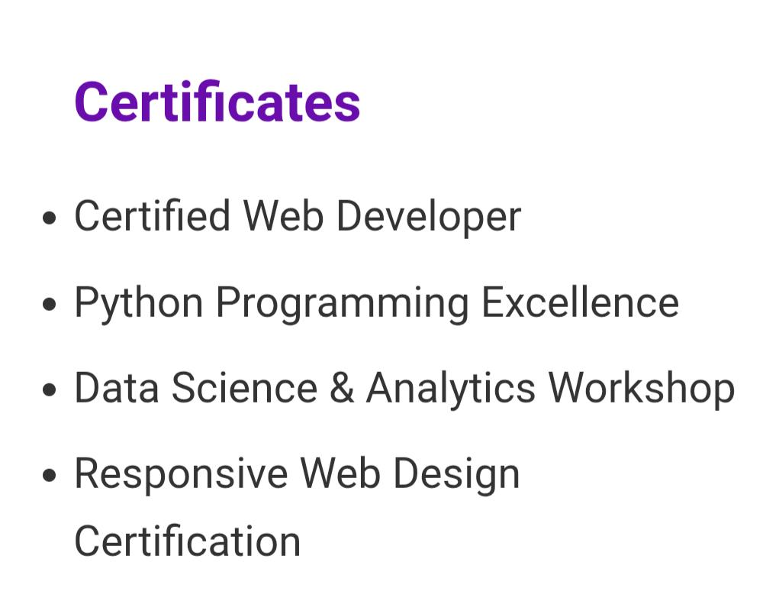
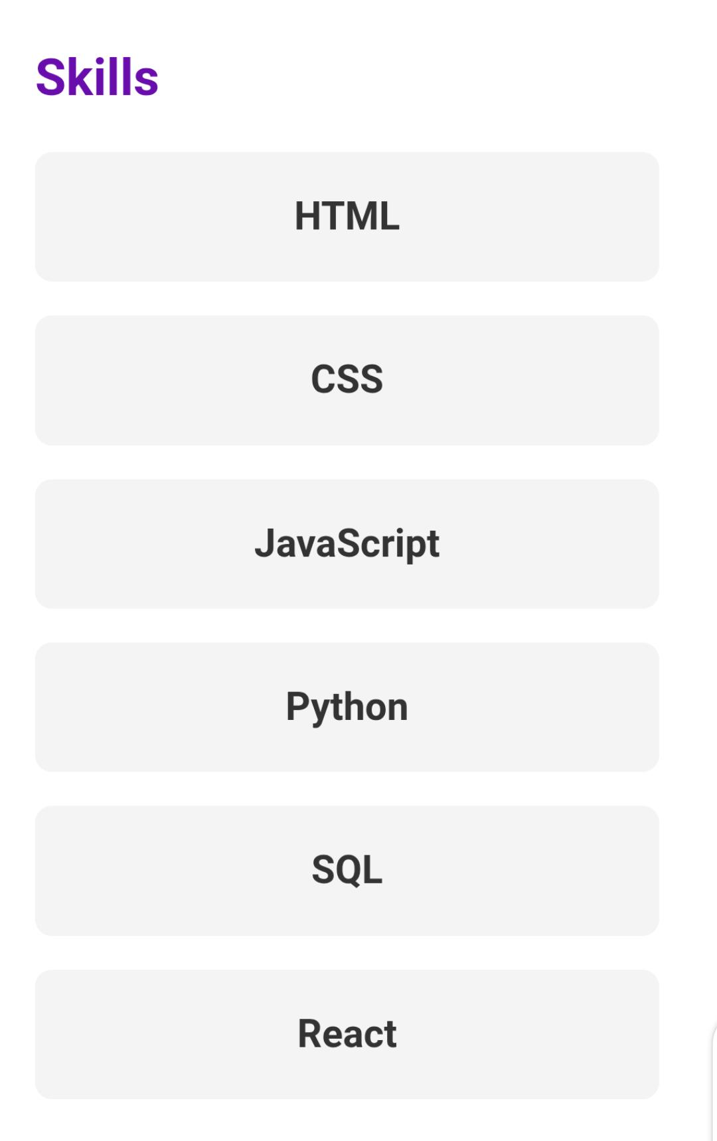
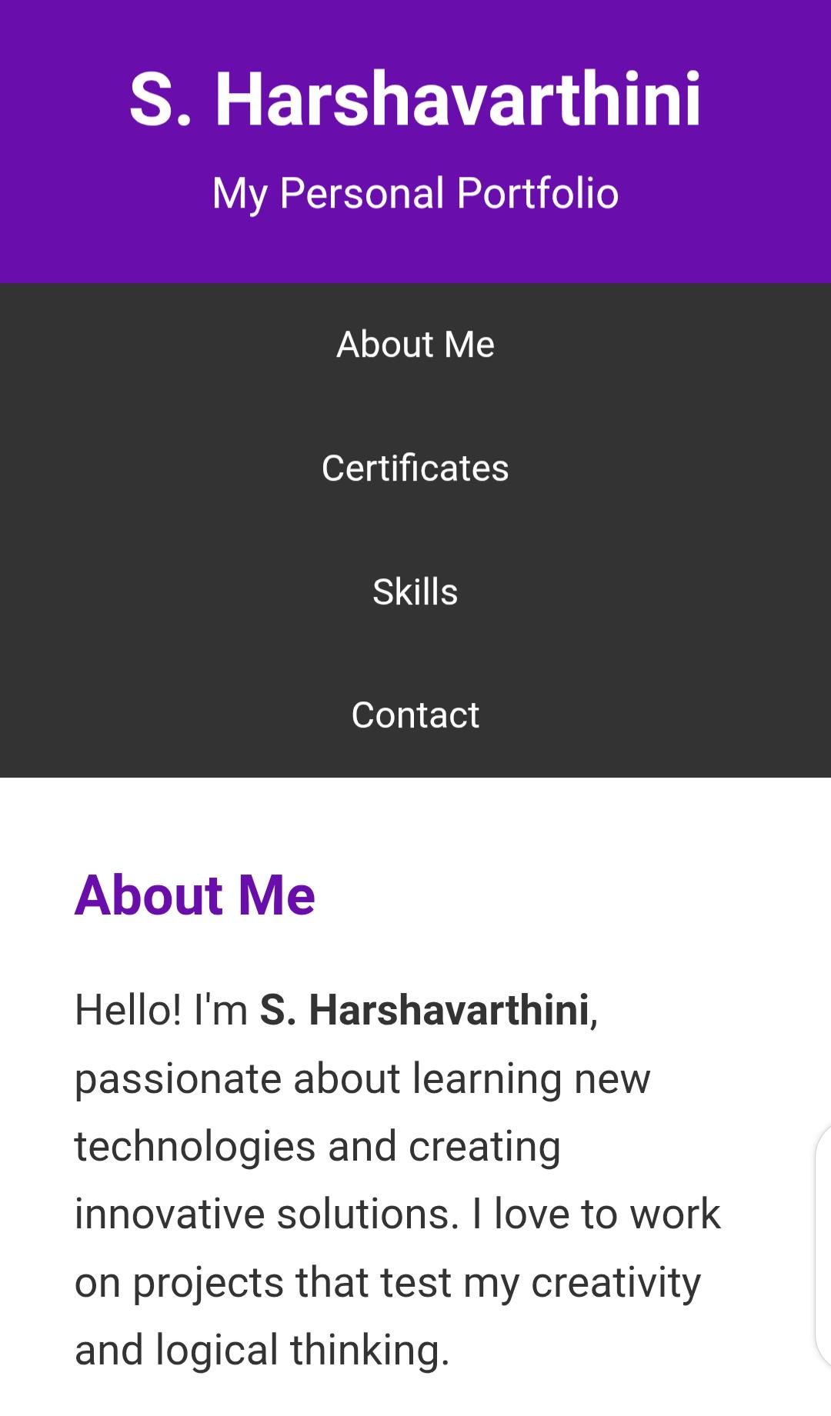
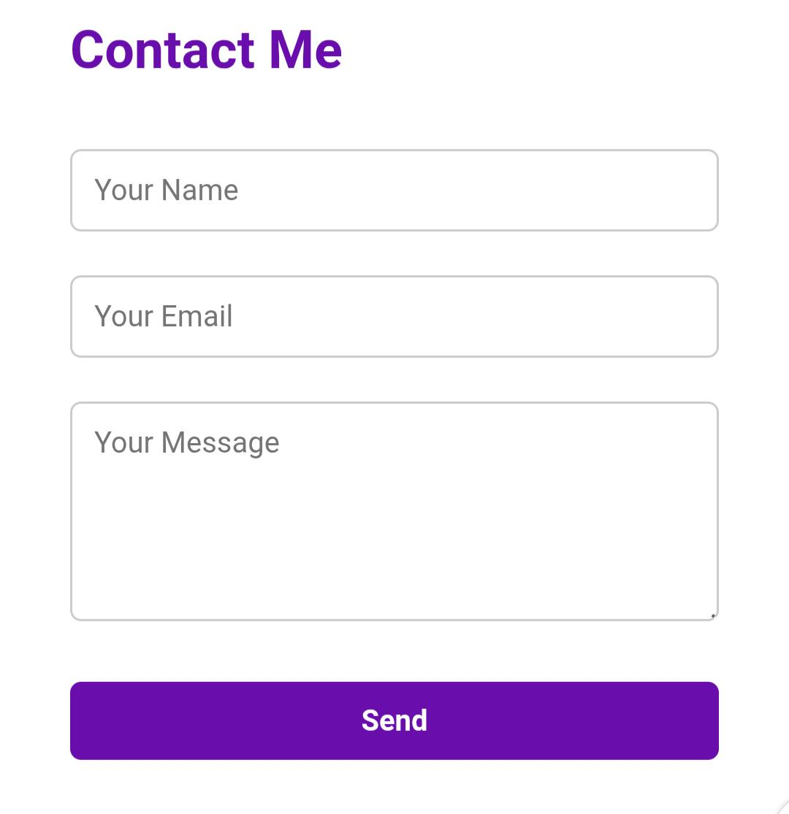
RESULTS AND SCREENSHOTS
3/21/2024 Annual Review
10

Slide 11
CONCLUSION
This portfolio highlights my skills, projects, and learning journey as a B.Sc. Computer Science student. It reflects my ability to apply technical knowledge in real-world projects and my interest in continuous improvement. Showcased academic and practical skills. Demonstrated front-end development and design knowledge.
11

Slide 12
GITHUB LINK
Project resume link : https://13112006harshavarthini.github.io/harshaportfolio/

